Slide 1
Python Course for Physicists (And everyone else!) Chunk 0: Preparation
By Jonathan Bollig
08.10.2025

Slide 2
Hi and welcome to my course. To save some time on Wednesday morning, I would like to ask you, to make some preparations.
For this, just follow the steps on the next 4 slides. If you encounter problems, don’t worry, we can fix them together (see last slide).

Slide 3
If python is installed already:
Download files and execute sample notebook (see last 2 slides)
If this works: Nice ☺
If not: Uninstall python and all related software (if you don‘t need it for other reasons) and continue with next slide.

Slide 4
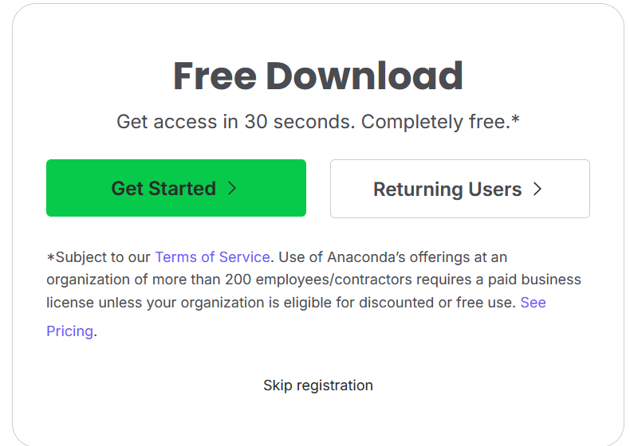
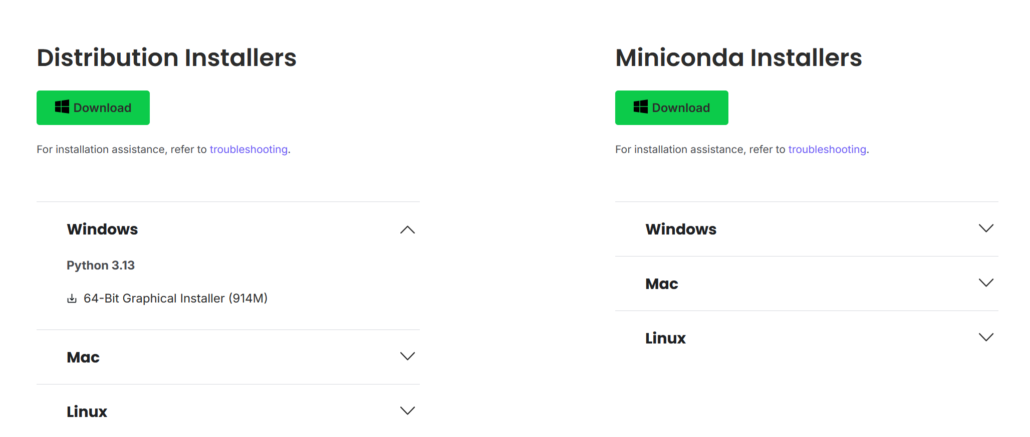
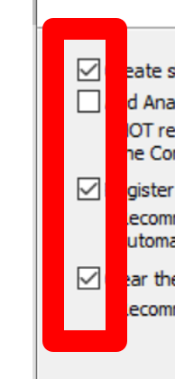
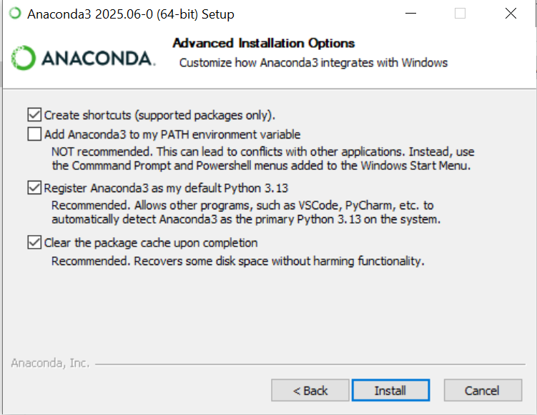
Installing Python
Anaconda: Single program to install, includes all scientific relevant packages. Visit https://www.anaconda.com/download
Skip Registration
Install Anaconda Distribution (left) or Miniconda if not 5 GB disc space (right)
Click through recommended steps, watch here:

Slide 5
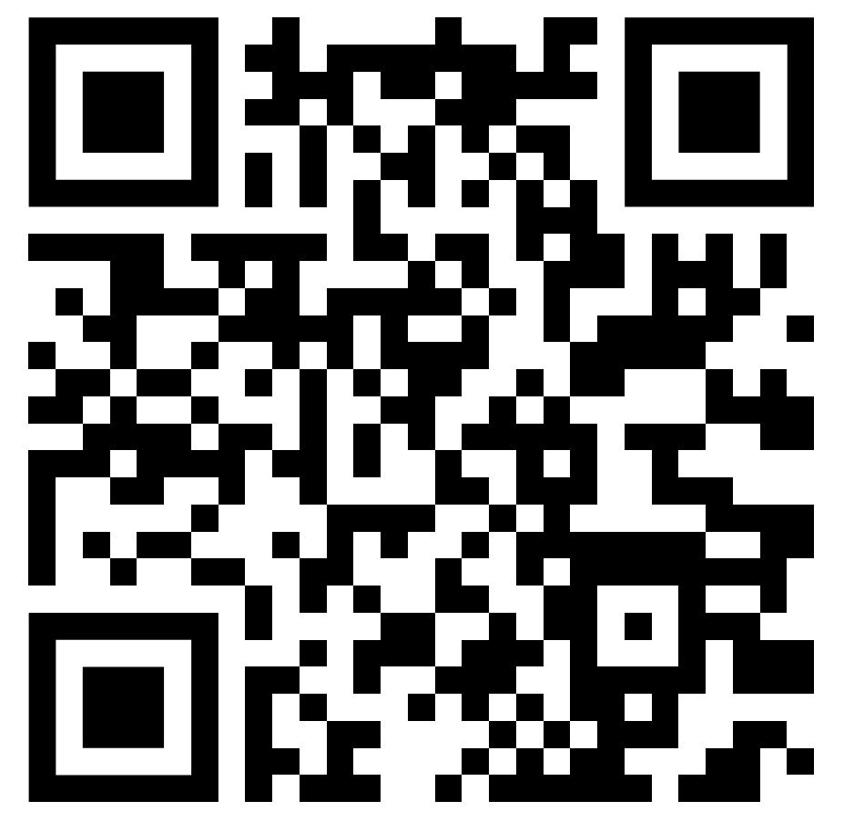
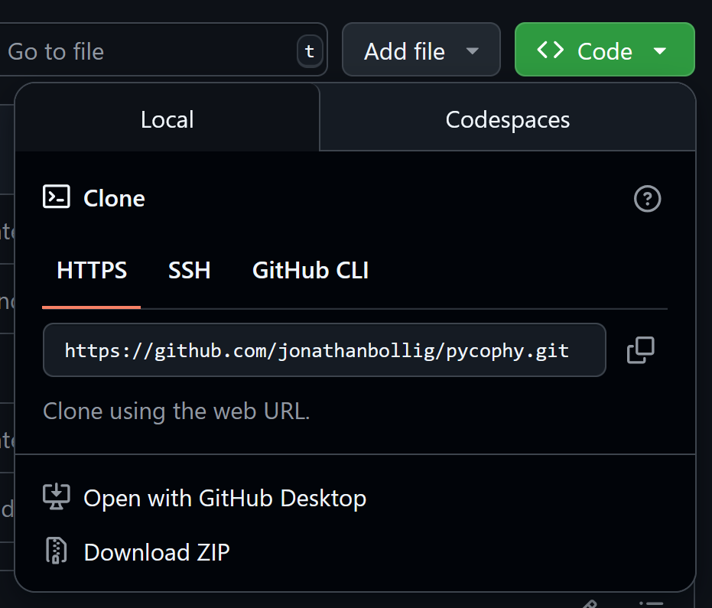
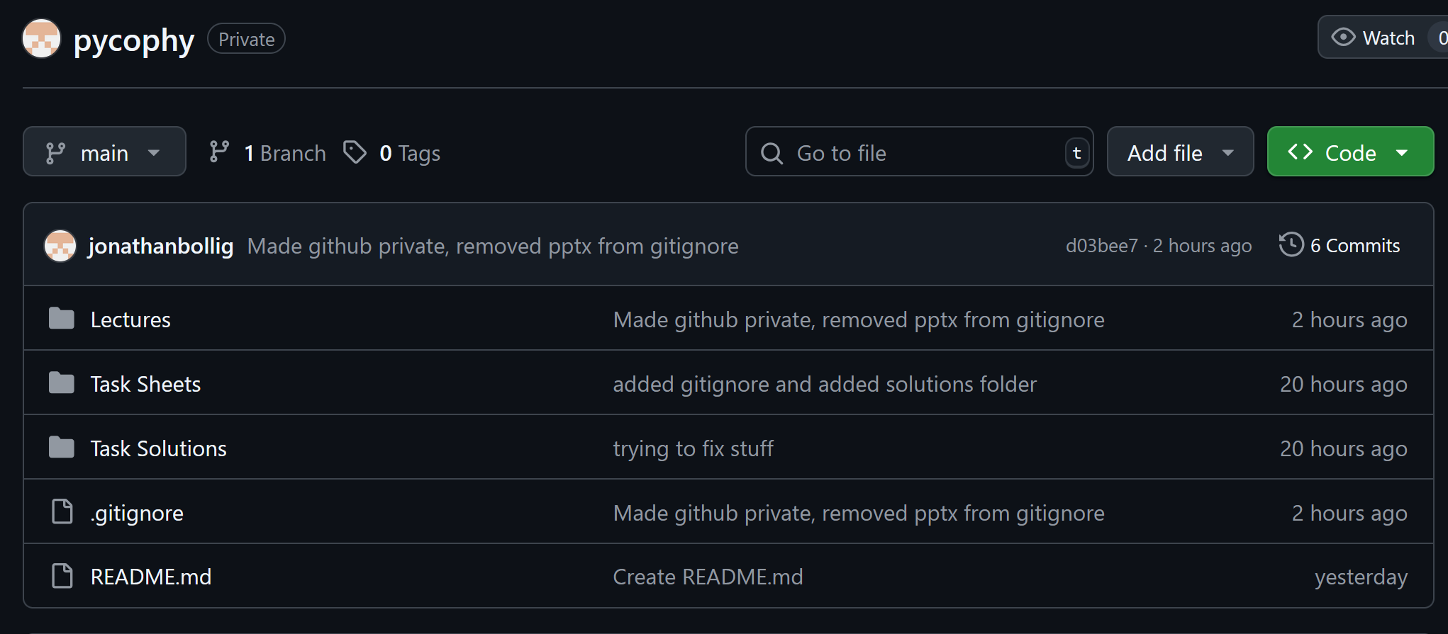
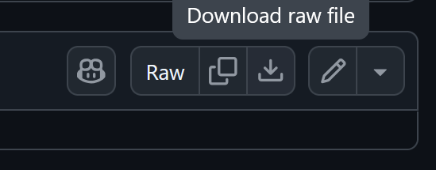
Git – Download Course Files
https://github.com/jonathanbollig/pycophy
Download ZIP with all course files:
Or: Download individual file:
Click on file, then top right corner:
Notes:
Here always the latest version available

Slide 6
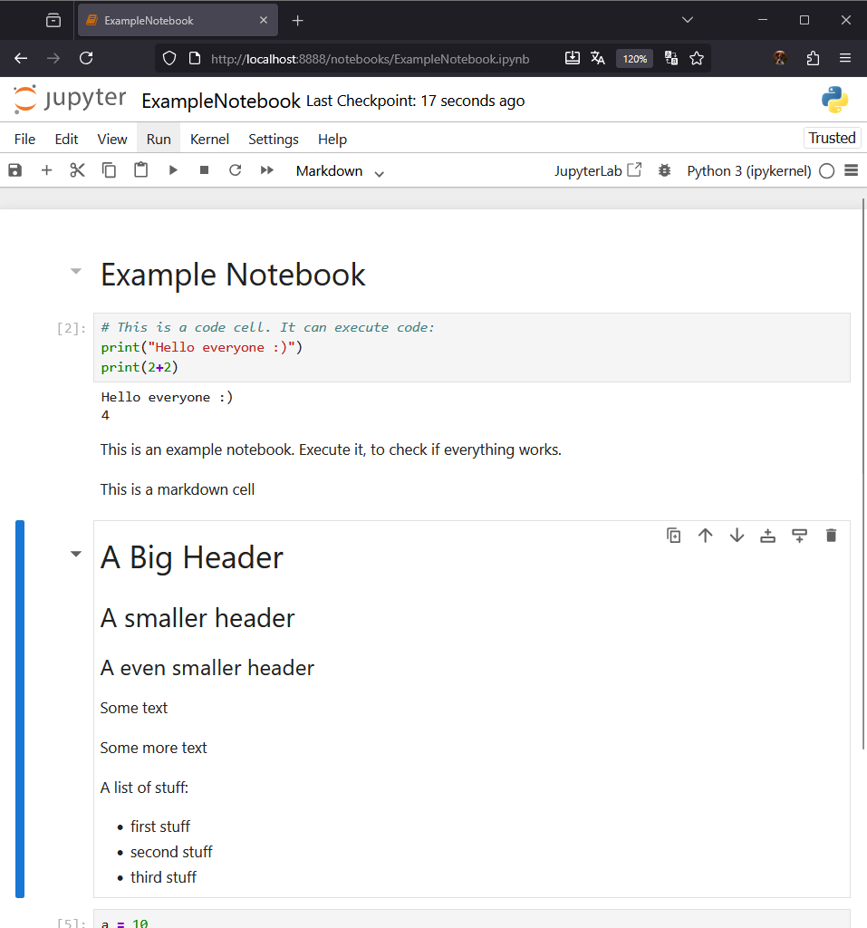
Execute Sample Notebook
When double clicking the notebook, it should open your default browser.
Try to execute the file (red box)
If asked, klick on Red button “Restart”
In case of problems:
Chill, and come 30 minutes earlier on Wednesday, so we can fix the problem together.
Please write jonathan.bollig@uni-jena.de a short mail, so I know how many problems to expect on Wednesday morning ☺

Slide 7
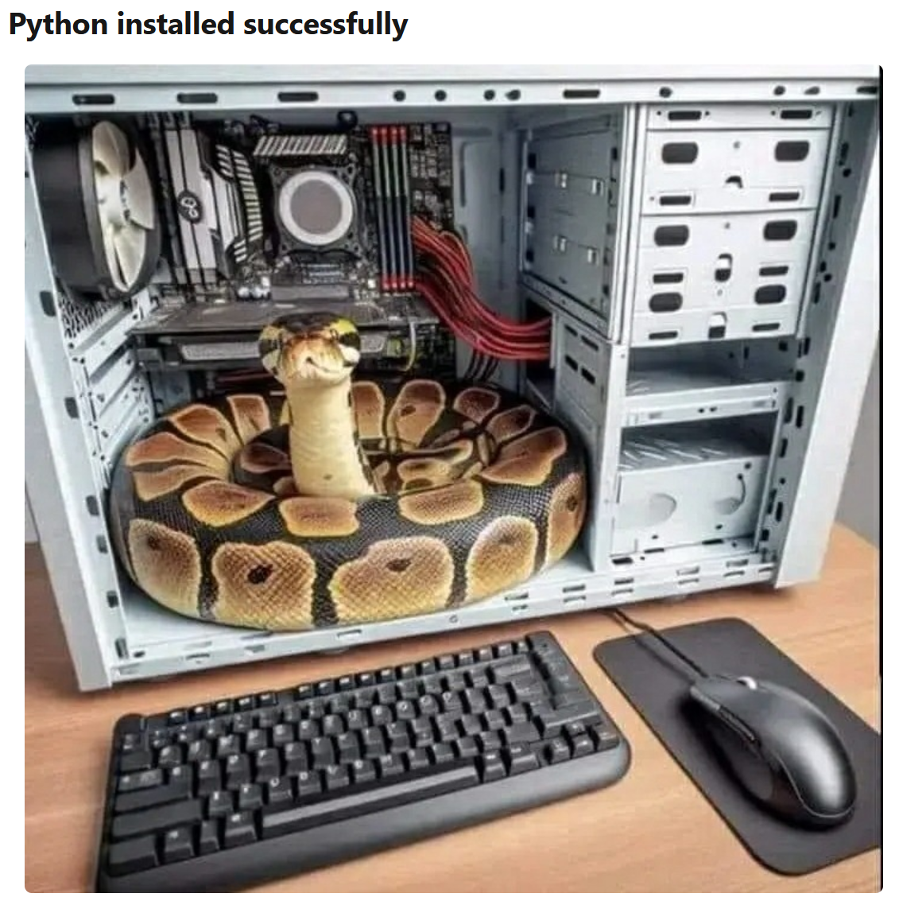
See you soon ☺
[https://dev.to/codeitbro/15-funniest-and-hilarious-python-coding-memes-2aij]

